Slide 1
THE CONCEPT OF WELFARE IN ISLAM

Slide 2
Islam is a religion
EMILE DURKHEIM
Religion is a unified system of beliefs and practices related to sacred things.

Slide 3
Religion = Identity
REZA ASLAN
[Religion is] a language made up of symbols and metaphors that allows people to communicate, to themselves and to others, the ineffable experience of faith.
FAITH: belief in, devotion to, or trust in somebody or something, especially without logical proof

Slide 4
Religion = Mazhab مذہب
مذہب: راستہ، طریقہ (فیروز الغات)
مسلک: قاعدہ، راستہ، دستور
قاعدہ: رسم، قانون، ضابطہ، دستور
رسم: نقش، تحریر، نشان، چال چلن، طور طریق، دستور، رواج،

Slide 5
The meaning of Islam
The word ‘Islam’ is from ‘Salama’ which means ‘protection, safety, reconciliation, harmony, peace’.
الْمُسْلِمُ مَنْ سَلِمَ الْمُسْلِمُوْنَ منْ لِّسَانِه وَيَدِه.

Slide 6
Literally, there are four meanings of the word ‘Islam’:
1. Peace
يَهْدِيْ بِهِ اﷲُ مَنِ اتَّبَعَ رِضْوَانَه سُبُلَ السَّلٰمِ.
Wherewith Allâh guides all those who seek His Good Pleasure to ways of peace (Quran, Almaida, 5:16).
2. Submission, Acceptance
اِذْ قَالَ لَه رَبُّه اَسْلِمْ قَالَ اَسْلَمْتُ لِرَبِّ الْعٰلَمِيْنَo
When his Lord said to him, "Submit (i.e. be a Muslim)!" He said, "I have submitted myself (as a Muslim) to the Lord of the 'Alamîn (mankind, jinns and all that exists)."

Slide 7
3. Reconciliation and Harmony
يٰاَيُّهَا الَّذِيْنَ اٰمَنُوا ادْخُلُوْا فِی السِّلْمِ کَآفَّةً.
O you who believe, you shall embrace total submission
4. Salama also refers to a very tall tree
Peace, Submission, Harmony, and Grandeaur

Slide 8
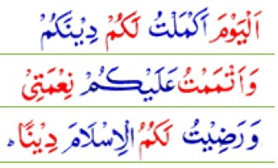
The last divine book, the Holy Quran, which according to our belief contains the words of Allah, has called Islam a complete way of life, and has chosen Islam as a way of life for all human beings (Al-Quran, 5:3).

Slide 9
When Islam is termed as complete way of life, it means it. i.e. no aspect of life – social , political, economic or personal, is out of the sphere of Islam.
Notes:
The Holy prophet Muhammad (PBUH) and his four caliphs (Khulafa-e-Rashedeen) made it an authority for the rest of time and world.
They actually united the temporal and spiritual authorities and practiced them in a human society and which in the first instance remained in practice for a century in one go. (till the period of Omar bin Abdul Aziz 717-820 AD or 99-101 AH).
During this period , even though the caliphate (Khilafat) was converted into dynastic kingship (Mulukiat), the basic structure of the Islamic state welfare services remained unaffected despite the fact that the public exchequer was in the hands of the kings or the so-called caliphs. It was the Islamic state and Government which laid the foundations of the first welfare State in the human history on this planet.

Slide 10
The sacred and the secular
Today, things and actions are divided into sacred and the secular, or Holy and unholy, Religious and Worldly. One is private and the other is social.
Sacred: Religious
Secular: Worldly, non-religious
The concept of sacred and secular is different in Islam.
Actions in themselves are neither sacred nor secular. It is the intention that makes them either sacred or secular.
e.g. Engineer constructing a dam for betterment of Allah’s creatures.
A carpenter doing his job in order to earn Halal money.
Notes:
However, Islam recognize this world as a source of salvation and prosperity in the eternal life in the world hereafter.
As a Muslim we believe in the fundamental that there is life after death and every one will be accountable for his/ her deeds and/or misdeeds.
Every socio-economic and political system is goal oriented and inconceivable without any organized community / society governed in accordance with the tenets of that system. Similarly Islam as a way of life is goal oriented and needs an organized society for its governance in accordance with its own tenets
Islam views life as a consistent whole and all the aspects of the human life whether economic, social or political, are considered as interdependent. ;there is no room for any aspect of life to be separated in secular and sacred.

Slide 11
The Islamic Approach to Social Welfare
Catering to the welfare of the people and relieving them of hardships is a basic objective of the Islamic State.
The Islamic concept of welfare encompasses all the welfare services which are known in the West as social services - education, health, rural development, agriculture, public health, sanitation, income maintenance, child welfare, law and order and any other aspect of material and social well-being.

Slide 12
Material and Spiritual Needs
The Islamic concept of welfare is much broader in the sense that it considers man not only in need of material needs but also in spiritual needs and Islam does take notice of that as well.
Man is made up of matter (clay)[1] and Islam wants his material well-being.
But that matter is also infused with a soul and matter and soul comprise an indivisible human being. Man’s material and spiritual needs are therefore, necessary and indivisible.
[1] Al-Quran, (Al-Hajr) 15: 26.

Slide 13
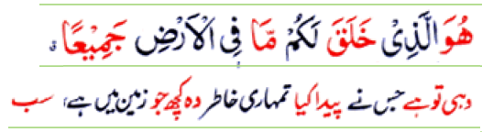
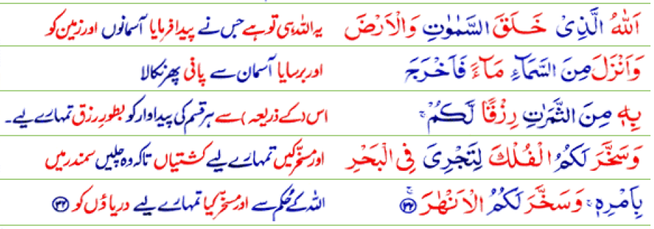
Resources on Earth
Al-Quran, Al-Baqara: 2.29.
Al-Quran, Al-Luqman, 31;20,
Al-Ibrahim 14:32.

Slide 14
From the verses mentioned in the previous slides, one might infer that God almighty has created resources for meeting the material needs on and above the earth and made them subject to the humans[1].
All these resources on, above or below the earth are for human beings and not for any particular privileged group/ class or country; and
it can therefore, also be inferred that they are meant for general welfare—the eradication of poverty and fulfilling the basic material needs of all humans.
[1] Al-Quran, Al-Baqara: 2.29. see also
Al-Quran, Al-Luqman, 31;20, Al-Ibrahim 14:32.

Slide 15
ISLAMIC PHILOSOPHY OF WELFARE
The basic philosophy of Islamic welfare system is that the Islamic state is not only to provide charity and basic needs to the citizens but a system, which removes all hindrances in the development of personality.
spiritual and material well being
The ultimate aim is to attain Saadah blessings of Allah, the Great, -a man’s best self and the attainment of perfection.
happiness, bliss, a central concept in Islamic philosophy to describe the highest aim of human striving, which can be reached through ethical perfection and increasing knowledge.

Slide 16
A-Ghazali and Islamic Welfare
Al-Ghazali (1058 –1111)
Mujaddid (تجدید کرنے والا) a renewer of the faith who appears once a century to restore faith of the Ummah)
Hujjat-ul-Islam (Proof of Islam)
Book: Ahi’aa ul Uloom ud Din (Revival of the Religious Sciences)
Book: Keemi’aa-e-Sa’adat (The Alchemy of Happiness)
He defined the objectives of the Islamic politico-Legal system as the
promotion of public welfare, and according to him public welfare refers to safeguarding faith, intellect, life, property and prosperity [1].
[1] Abu Hamid Al-Ghazali, Al-Musatafa Vol.-I.. Al-Maktaba Al-Tajiran Kurba, Cairo,pp.130-40

Slide 17
Development of Personality through attaining Saada’a
AL-GHAZALI
Welfare →
safeguarding faith
intellect
life
property and
Prosperity

Slide 18
Hence, in an Islamic State all the organizations and institutions should reflect the characteristic of merciful blessings and cater for the welfare of all people.
Alongside material prosperity the Quranic commands emphasize the spiritual aspect of humanity, for Islam helps a man both in this world and in the world hereafter.

